Slide 1

Track Sales Leads Power Apps Canvas App
Efficiently organize, track and manage sales leads.
Notes:
Welcome to the presentation on Track Sales Leads Power Apps Canvas App. In this presentation, you will learn about the purpose, features and benefits of this app.

Slide 2

Presentation Overview
Introduction to Track Sales Leads App
We will introduce you to the Track Sales Leads Power Apps Canvas App and provide an overview of its functionalities.
Features of Track Sales Leads App
We will go over the key features of the Track Sales Leads App, including lead management, customization and integration.
Benefits of using Track Sales Leads App
We will discuss the benefits of using the Track Sales Leads App, including increased productivity, improved communication and enhanced customer experience.
Notes:
First, we will introduce you to the Track Sales Leads Power Apps Canvas App. Next, we will go over its features, including lead management, customization and integration. Finally, we will discuss the benefits of using this app, such as increased productivity, improved communication and enhanced customer experience.

Slide 3

Introduction of the Track Sales Leads Power Apps Canvas App
Purpose of the App
The purpose of the Track Sales Leads Power Apps Canvas App is to help sales teams manage their leads effectively and efficiently.
Accessibility
The Track Sales Leads Power Apps Canvas App is an easy-to-use app that can be accessed from anywhere, making it an indispensable tool for sales professionals.
App Overview
The Track Sales Leads Power Apps Canvas App provides users with a comprehensive view of their sales leads, allowing them to easily manage and update lead information, track progress, and collaborate with team members.
Notes:
The Track Sales Leads Power Apps Canvas App is a powerful tool that helps sales teams to manage their leads effectively. It is an easy-to-use app that can be accessed from anywhere, making it an indispensable tool for sales professionals. In this section, we will explore the purpose, how to access and the overview of the app.

Slide 4

Purpose of the App
Effective Lead Management
The Track Sales Leads Power Apps Canvas App helps sales teams to manage their leads effectively by allowing them to capture leads, track sales activities, and manage customer accounts in one place.
Streamlined Sales Process
The Track Sales Leads Power Apps Canvas App streamlines the sales process by making it easier for sales teams to manage their leads and close deals faster.
Notes:
The purpose of the Track Sales Leads Power Apps Canvas App is to help sales teams to manage their leads effectively. The app allows sales teams to capture leads, track sales activities and manage customer accounts in one place. It streamlines the sales process, making it easier for sales teams to close deals faster.

Slide 5

How to Access the App
Access from Anywhere on Any Device
The Track Sales Leads Power Apps Canvas App is designed to be accessed from anywhere on any device, making it a convenient and accessible tool for sales teams.
Download from Microsoft AppSource
The Track Sales Leads Power Apps Canvas App can be downloaded from the Microsoft AppSource, making it easy to install and use. This is especially useful for sales teams that are always on the go.
Access Through Web Browser
The Track Sales Leads Power Apps Canvas App can also be accessed through a web browser, providing even more flexibility and accessibility for sales teams.
Integration with Microsoft Products
The Track Sales Leads Power Apps Canvas App can be integrated with other Microsoft products, such as Dynamics 365, providing a seamless experience for sales teams and streamlining their workflow.
Notes:
The Track Sales Leads Power Apps Canvas App can be accessed from anywhere on any device. It can be downloaded from the Microsoft AppSource or accessed through a web browser. The app can be integrated with other Microsoft products, such as Dynamics 365, making it a seamless experience for sales teams.

Slide 6

Overview of the App
User-Friendly Interface
The Track Sales Leads Power Apps Canvas App has a user-friendly interface that is easy to navigate, allowing sales teams to quickly and efficiently manage leads, sales activities, and customer accounts.
Lead Management
The app allows sales teams to create and manage leads, ensuring that leads are properly tracked and followed up on, ensuring that no opportunity is missed.
Sales Activity Tracking
The app allows sales teams to track sales activities, ensuring that all sales activities are properly recorded and followed up on.
Real-Time Sales Performance Insights
The app provides real-time insights into sales performance, allowing sales teams to make data-driven decisions and ensuring that the sales team is always on track to meet their targets.
Notes:
The Track Sales Leads Power Apps Canvas App has a user-friendly interface that is easy to navigate. The app allows sales teams to create and manage leads, track sales activities, and manage customer accounts. It also provides real-time insights into sales performance, allowing sales teams to make data-driven decisions.

Slide 7

Features of the Track Sales Leads Power Apps Canvas App
Lead Management
The Track Sales Leads Power Apps Canvas App offers robust lead management features that allow users to track and manage leads throughout the sales process, from lead capture to conversion.
Customization
The Track Sales Leads Power Apps Canvas App is highly customizable, allowing users to tailor the app to meet their specific business needs and requirements.
Integration
The Track Sales Leads Power Apps Canvas App seamlessly integrates with other Microsoft applications, such as Dynamics 365 and Excel, allowing users to streamline their sales processes and maximize productivity.
Notes:
In this section, we will explore the features of the Track Sales Leads Power Apps Canvas App. These features include lead management, customization and integration.

Slide 8

Lead Management
Lead Capture
The Track Sales Leads Power Apps Canvas App allows sales teams to capture leads easily and efficiently.
Sales Activity Tracking
The app allows the sales team to track their sales activities in real-time and manage customer accounts effectively.
Lead Prioritization
The app allows sales teams to prioritize leads and track their status easily. This feature helps sales teams to close deals faster by focusing on high-priority leads.
Notes:
The Track Sales Leads Power Apps Canvas App has powerful features for lead management. Sales teams can capture leads, track sales activities and manage customer accounts in one place. The app allows sales teams to see the status of each lead, making it easier to prioritize leads and close deals faster.

Slide 9

Customization
Highly Customizable
The Track Sales Leads Power Apps Canvas App is highly customizable, allowing sales teams to create custom fields, dashboards and reports that meet their specific needs.
Custom Fields
Sales teams can create custom fields in the Track Sales Leads Power Apps Canvas App, which allows them to collect and organize data that is unique to their sales process.
Custom Dashboards and Reports
Sales teams can also create custom dashboards and reports in the Track Sales Leads Power Apps Canvas App, which allows them to visualize and analyze data in a way that is most useful to them.
Notes:
The Track Sales Leads Power Apps Canvas App is highly customizable. Sales teams can create custom fields, dashboards and reports that meet their specific needs. This flexibility allows sales teams to tailor the app to their unique sales process, making them more productive.

Slide 10

Integration with Other Apps
Integration with Dynamics 365
The Track Sales Leads Power Apps Canvas App seamlessly integrates with Dynamics 365, allowing sales teams to access customer data from multiple sources. This integration streamlines the sales process, making it easier to close deals faster.
Integration with LinkedIn Sales Navigator
The Track Sales Leads Power Apps Canvas App integrates with LinkedIn Sales Navigator, providing sales teams with valuable insights into their leads. This integration allows sales teams to make informed decisions, resulting in higher conversion rates.
Notes:
The Track Sales Leads Power Apps Canvas App seamlessly integrates with other Microsoft products, such as Dynamics 365. This integration allows sales teams to access customer data from multiple sources, making it easier to close deals faster. The app also integrates with other third-party apps, such as LinkedIn Sales Navigator, allowing sales teams to get insights into their leads.

Slide 11
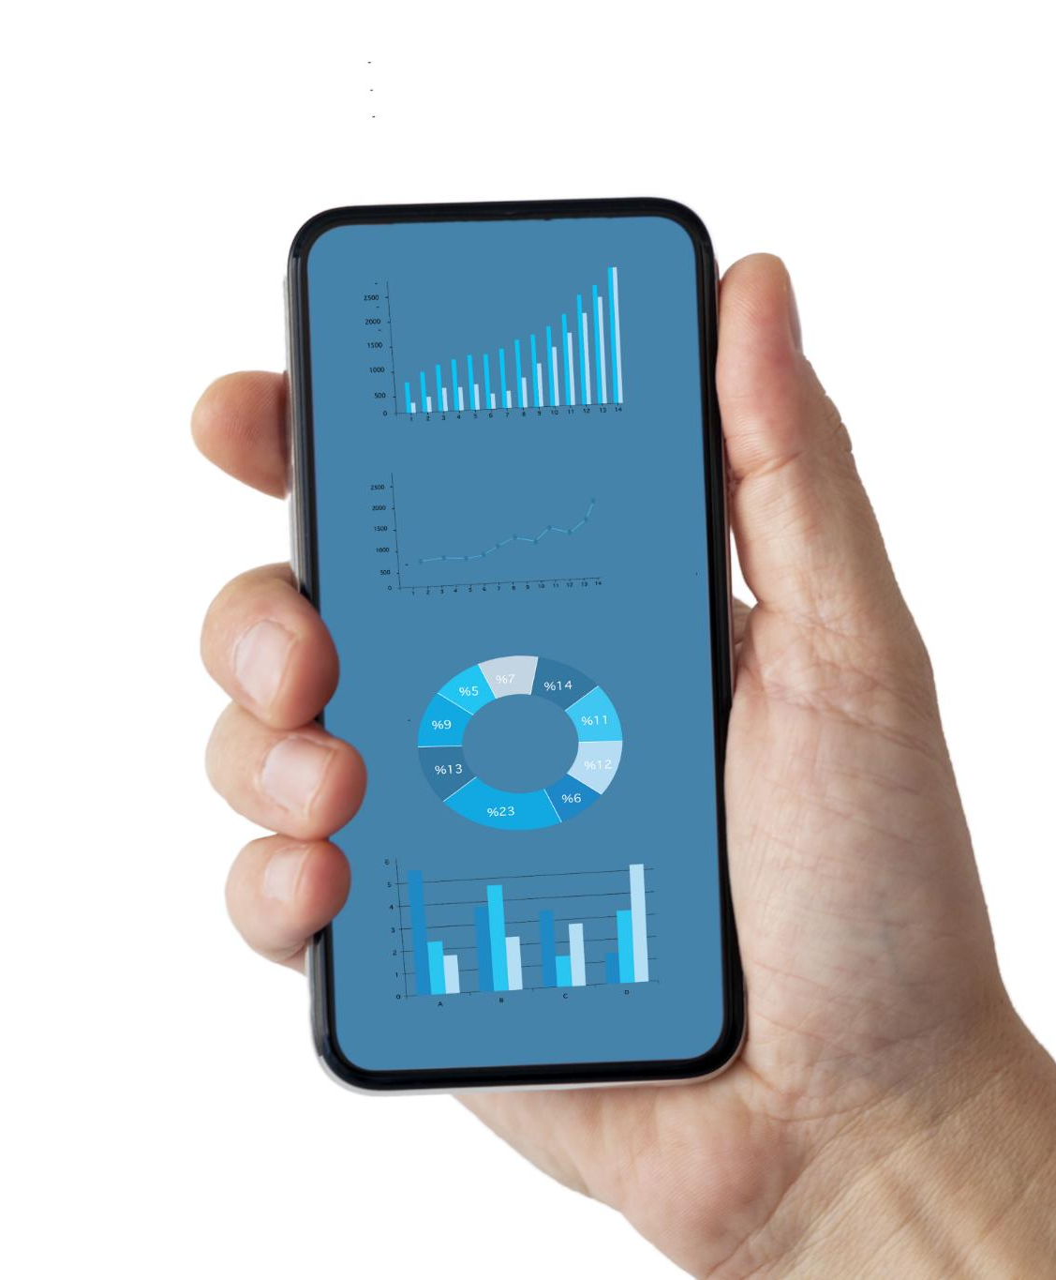
Benefits of the Track Sales Leads Power Apps Canvas App
Increased Productivity
Using the Track Sales Leads Power Apps Canvas App increases productivity by providing a centralized location for managing leads, reducing time spent on manual data entry, and enabling quick updates on the go.
Improved Communication
The Track Sales Leads Power Apps Canvas App improves communication by providing a platform for collaboration, enabling real-time updates, and enhancing customer interactions.
Enhanced Customer Experience
Using the Track Sales Leads Power Apps Canvas App enhances the customer experience by enabling personalized interactions, improving response times, and providing a seamless sales process.
Notes:
In this section, we will discuss the benefits of using the Track Sales Leads Power Apps Canvas App. These benefits include increased productivity, improved communication, and enhanced customer experience.

Slide 12

Increased Productivity
Streamlined Sales Process
The Track Sales Leads Power Apps Canvas App streamlines the sales process, making sales teams more productive by allowing them to manage leads, track sales activities, and manage customer accounts in one place.
Real-time Sales Insights
The Track Sales Leads Power Apps Canvas App provides real-time insights into sales performance, enabling sales teams to make data-driven decisions that increase their productivity and sales effectiveness.
Notes:
The Track Sales Leads Power Apps Canvas App streamlines the sales process, making sales teams more productive. The app allows sales teams to manage leads, track sales activities and manage customer accounts in one place. It also provides real-time insights into sales performance, allowing sales teams to make data-driven decisions.

Slide 13

Improved Communication
Improved Access to Customer Data
The Track Sales Leads Power Apps Canvas App improves communication by allowing sales teams to access customer data from multiple sources, making it easier to close deals faster.
Collaboration with Team Members
The Track Sales Leads Power Apps Canvas App improves communication by allowing sales teams to collaborate with other team members, making them more efficient.
Notes:
The Track Sales Leads Power Apps Canvas App improves communication between sales teams and their customers. The app allows sales teams to access customer data from multiple sources, making it easier to close deals faster. This app also allows sales teams to collaborate with other team members, making them more efficient.

Slide 14

Enhanced Customer Experience
Real-Time Customer Insights
The Track Sales Leads Power Apps Canvas App provides sales teams with real-time insights into customer needs and preferences, allowing for personalized service that enhances the overall customer experience.
Access to Customer Data
The app allows sales teams to access customer data from multiple sources, making it easier to provide personalized service and improving the overall customer experience.
Faster Response to Inquiries
The app allows sales teams to respond to customer inquiries faster, improving customer satisfaction and enhancing the overall customer experience.
Notes:
The Track Sales Leads Power Apps Canvas App enhances the customer experience by providing sales teams with real-time insights into customer needs and preferences. The app allows sales teams to access customer data from multiple sources, making it easier to provide personalized service. This app also allows sales teams to respond to customer inquiries faster, improving customer satisfaction.

Slide 15

Conclusion
User-Friendly Interface
The Track Sales Leads Power Apps Canvas App has a user-friendly interface that makes it easy for sales teams to manage their leads effectively with minimal training.
Seamless Integration
The Track Sales Leads Power Apps Canvas App seamlessly integrates with other Microsoft products, making it easy for sales teams to work across different platforms and devices.
Real-Time Insights
The Track Sales Leads Power Apps Canvas App provides real-time insights into sales performance, allowing sales teams to make data-driven decisions and close deals faster.
Enhanced Communication and Customer Experience
By using the Track Sales Leads Power Apps Canvas App, sales teams can improve communication with customers and enhance their experience, leading to increased customer satisfaction and loyalty.
Notes:
The Track Sales Leads Power Apps Canvas App is a powerful tool that helps sales teams to manage their leads effectively. It has a user-friendly interface, powerful features for lead management, and seamless integration with other Microsoft products. It also provides real-time insights into sales performance, making sales teams more productive. By using this app, sales teams can improve communication, enhance the customer experience and close deals faster.

